Slide 1
Adding Style with Bootstrap

Slide 2

Overview
Working with text and typography
Using Bootstrap for content elements Adding layout style classes

Slide 3
Working with Text and Typography

Slide 4
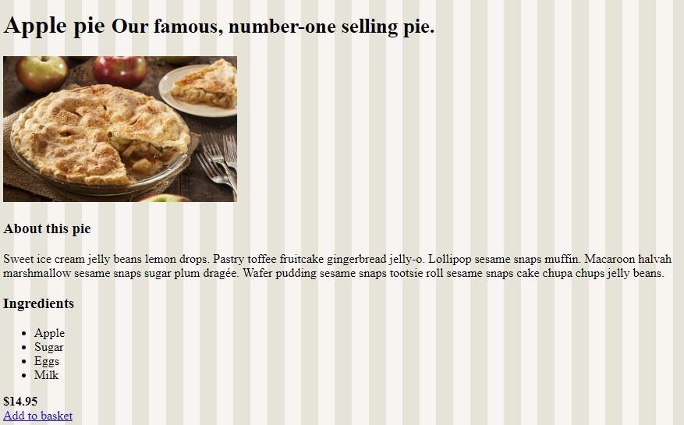
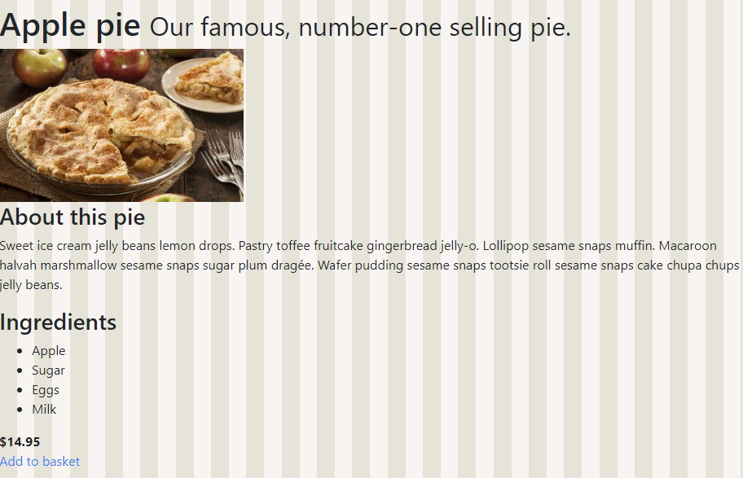
It’s All Pretty Boring…

Slide 5
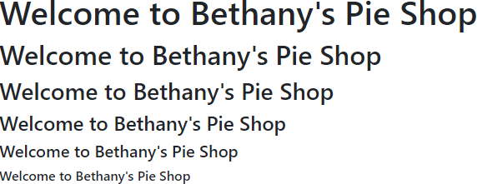
Headings
<h1>Welcome to Bethany's Pie Shop</h1>
<h2>Welcome to Bethany's Pie Shop</h2>
<h3>Welcome to Bethany's Pie Shop</h3>
<h4>Welcome to Bethany's Pie Shop</h4>
<h5>Welcome to Bethany's Pie Shop</h5>
<h6>Welcome to Bethany's Pie Shop</h6>

Slide 6

Display Headings
<h1 class="display-1">Welcome to Bethany's Pie Shop</h1>
<h1 class="display-2">Welcome to Bethany's Pie Shop</h1>
<h1 class="display-3">Welcome to Bethany's Pie Shop</h1>
<h1 class="display-4">Welcome to Bethany's Pie Shop</h1>

Slide 7
Text Inline Elements
<mark>
<small>
<u>
<em>
<strong>
<s>

Slide 8
text-center, text-left, text-right
text-sm-left text-wrap text-break text-primary text-white
◀ Align text
◀ Align left for certain viewport
◀ Wrap text
◀ Break on long words
◀ Text color to primary color
◀ Text to white

Slide 9
Demo
Working with type and text

Slide 10
Using Bootstrap for Content Elements

Slide 11
Demo
Applying style on tables

Slide 12
Demo
Working with images

Slide 13
Adding Layout Style Classes

Slide 14



Spacing Using Bootstrap
Support for padding (p) and margin (m)
All properties or individual properties
Based on rem value

Slide 15
Applying a Margin
mt-1
margin
top amount

Slide 16
<span class="border"></span>
<span class="border-bottom"></span>
<span class="border border-primary"></span>
Adding Borders

Slide 17
Demo
Adding style classes to our site

Slide 18
Summary
Bootstrap helps on many levels
Traditional tables
Images
Spacing and alignment

Slide 19


Up next:
Exploring Bootstrap components

